Slide 1
Chapter 8
Packages and Interfaces
李晔锋

Slide 2
Key Skills & Concepts
Use packages
Understand how packages affect access
Apply the protected access modifier
Import packages
Know Java’s standard packages
Understand interface fundamentals
Implement an interface
Apply interface references
Understand interface variables
Extend interfaces
Create default, static, and private interface methods

Slide 3
Packages
A package serves two purposes.
First, it provides a mechanism by which related pieces of a program can be organized as a unit. Classes defined within a package must be accessed through their package name.
Second, a package participates in Java’s access control mechanism. Classes defined within a package can be made private to that package and not accessible by code outside the package.

Slide 4
Defining a Package
All classes in Java belong to some package. When no package statement is specified, the default (global) package is used. Furthermore, the default package has no name, which makes the default package transparent.
To create a package, put a package command at the top of a Java source file. The classes declared within that file will then belong to the specified package. This is the general form of the package statement:
package pkg;
Java uses the file system to manage packages, with each package stored in its own directory.

Slide 5
Defining a Package
You can create a hierarchy of packages. To do so, simply separate each package name from the one above it by use of a period. The general form of a multileveled package statement is shown here:
package pack1.pack2.pack3...packN;
Of course, you must create directories that support the package hierarchy that you create:
pack1/pack2/pack3/…/packN

Slide 6
A Short Package Example
package bookpack;
public class BookDemo {
public static void main(String[] args) {
// TODO Auto-generated method stub
Book books[] = new Book[5];
books[0] = new Book("Java: A Beginner's Guide",
"Schildt",2018);
books[1] = new Book("Java: The Complete Reference",
"Schildt",2018);
books[2] = new Book("Introducing JavaFX 8 Programming",
"Schildt",2015);
books[3] = new Book("Red Storm Rising",
"Clancy",1986);
books[4] = new Book("On the Road",
"Kerouac",1955);
for(int i=0; i<books.length;i++) books[i].show();
}
}
package bookpack;
public class Book {
private String title;
private String author;
private int pubDate;
Book(String t, String a, int d){
title = t;
author = a;
pubDate = d;
}
void show(){
System.out.println(title);
System.out.println(author);
System.out.println(pubDate);
System.out.println();
}
}

Slide 7
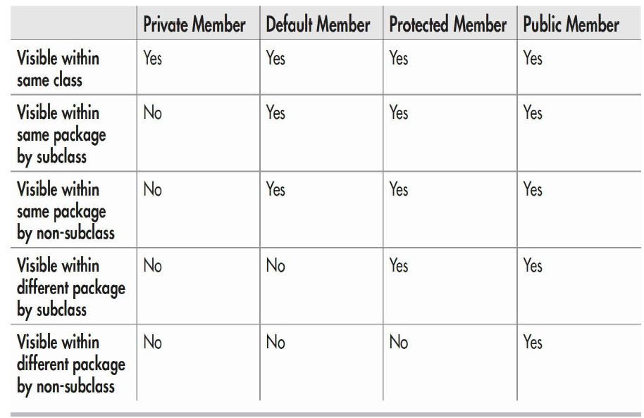
Packages and Member Access

Slide 8
A Package Access Example
package bookpack;
public class Book {
private String title;
private String author;
private int pubDate;
public Book(String t, String a, int d){
title = t;
author = a;
pubDate = d;
}
public void show(){
System.out.println(title);
System.out.println(author);
System.out.println(pubDate);
System.out.println();
}
}

Slide 9
A Package Access Example
package bookpackext;
public class UseBook {
public static void main(String[] args) {
// TODO Auto-generated method stub
bookpack.Book books[] = new bookpack.Book[5];
books[0] = new bookpack.Book("Java: A Beginner's Guide",
"Schildt",2018);
books[1] = new bookpack.Book("Java: The Complete Reference",
"Schildt",2018);
books[2] = new bookpack.Book("Introducing JavaFX 8 Programming",
"Schildt",2015);
books[3] = new bookpack.Book("Red Storm Rising",
"Clancy",1986);
books[4] = new bookpack.Book("On the Road",
"Kerouac",1955);
for(int i=0; i<books.length;i++) books[i].show();
}
}

Slide 10
Understanding Protected Members
The protected modifier creates a member that is accessible within its package and to subclasses in other packages.
Thus, a protected member is available for all subclasses to use but is still protected from arbitrary access by code outside its package.

Slide 11
package bookpack;
public class Book {
protected String title;
protected String author;
protected int pubDate;
public Book(String t, String a, int d){
title = t;
author = a;
pubDate = d;
}
public void show(){
System.out.println(title);
System.out.println(author);
System.out.println(pubDate);
System.out.println();
}
}
package bookpackext;
public class ExtBook extends bookpack.Book {
private String publisher;
public ExtBook(String t, String a, int d, String p) {
super(t,a,d);
publisher = p;
}
public void show() {
super.show();
System.out.println(publisher);
System.out.println();
}
public String getTitle() {return title;}
public void setTitle(String t) {title =t;}
public String getAuthor() {return author;}
public void setAuthor(String a) {author =a;}
public int getPubDate() {return pubDate;}
public void setPubDate(int d) {pubDate = d;}
}

Slide 12
package bookpackext;
public class ProtectDemo {
public static void main(String[] args) {
// TODO Auto-generated method stub
ExtBook books[] = new ExtBook[5];
books[0] = new ExtBook("Java: A Beginner's Guide",
"Schildt",2018,"Oracle Press");
books[1] = new ExtBook("Java: The Complete Reference",
"Schildt",2018,"Oracle Press");
books[2] = new ExtBook("Introducing JavaFX 8 Programming",
"Schildt",2015,"Oracle Press");
books[3] = new ExtBook("Red Storm Rising",
"Clancy",1986,"Putnam");
books[4] = new ExtBook("On the Road",
"Kerouac",1955,"Viking");
for(int i = 0; i < books.length; i++)
if(books[i].getAuthor() == "Schildt")
System.out.println(books[i].getTitle());
}
}

Slide 13
Importing Packages
Using import you can bring one or more members of a package into view. This allows you to use those members directly, without explicit package qualification. Here is the general form of the import statement:
import pkg.classname;
Here, pkg is the name of the package, which can include its full path, and classname is the name of the class being imported. If you want to import the entire contents of a package, use an asterisk (*) for the class name.
import pkg.*;

Slide 14
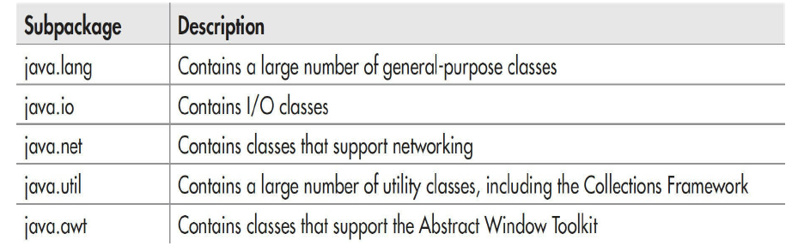
Java’s Class Library Is Contained in Packages

Slide 15
Interfaces
An interface is syntactically similar to an abstract class, in that you can specify one or more methods that have no body. Those methods must be implemented by a class in order for their actions to be defined.
To implement an interface, a class must provide bodies (implementations) for the methods described by the interface. Each class is free to determine the details of its own implementation.

Slide 16
General Form of an Interface
access interface name {
ret-type method-name1(param-list);
ret-type method-name2(param-list);
type var1 = value;
type var2 = value;
// ...
ret-type method-nameN(param-list);
type varN = value;
}

Slide 17
Interface Description Details
For a top-level interface, access is either public or not used. Then the access right is the same as those of classes.
Inside the interface body, variables declared are implicitly public, final, and static and must be initialized.
Inside the interface body, methods declared are implicitly public and abstract, thus the method body is not required.

Slide 18
Interface Example
public interface Series {
int getNext(); //return next number in series
void reset(); //restart
void setStart(int x); //set starting value
}

Slide 19
Create an Interface in Eclipse
Right click on the directory, select “new” → “Interface”.
Fill in the interface name and then click “finish”.

Slide 20
Implementing Interfaces
Once an interface has been defined, one or more classes can implement that interface. Also one class can implement multiple interfaces. The general form is as follows:
class classname implements interface1, interface2, … {
// class-body
}
All the methods declared in the interface(s) must be implemented in the class, and they must be declared public. Also, the type signature of the implementing method must match exactly the type signature specified in the interface definition.

Slide 21
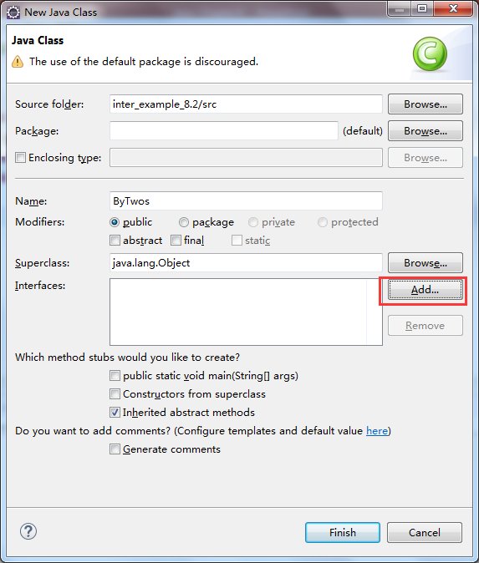
Class Implementation Using Eclipse

Slide 22
public class ByTwos implements Series {
int start;
int val;
ByTwos(){
start = 0;
val = 0;
}
@Override
public int getNext() {
val += 2;
return val;
}
@Override
public void reset() {
val = start;
}
@Override
public void setStart(int x) {
start = x;
val = x;
}
}

Slide 23
public class SeriesDemo {
public static void main(String[] args) {
// TODO Auto-generated method stub
ByTwos ob = new ByTwos();
for(int i = 0; i < 5; i++)
System.out.println("Next value is " +
ob.getNext());
System.out.println("\nResetting");
ob.reset();
for(int i = 0; i < 5; i++)
System.out.println("Next value is " +
ob.getNext());
System.out.println("\nStarting at 100");
ob.setStart(100);
for(int i = 0; i < 5; i++)
System.out.println("Next value is " +
ob.getNext());
}
}

Slide 24
Implementing Interfaces
It is both permissible and common for classes that implement interfaces to define additional members of their own.
However, since the interface to those methods stays the same, the change is seamless and does not break preexisting code. This is one of the advantages of interfaces.
As explained, any number of classes can implement an interface.

Slide 25
public class ByThrees implements Series {
int start;
int val;
ByThrees(){
start = 0;
val = 0;
}
@Override
public int getNext() {
val += 3;
return val;
}
@Override
public void reset() {
val = start;
}
@Override
public void setStart(int x) {
start = x;
val = x;
}
}

Slide 26
Implementing Interfaces
If a class includes an interface but does not fully implement the methods defined by that interface, then that class must be declared as abstract. No objects of such a class can be created, but it can be used as an abstract superclass, allowing subclasses to provide the complete implementation.

Slide 27
A More Comprehensive Example
Interface only concerns about the what to do, but does not concern about how to do.
interface 收费 {
public void 收取费用();
}
interface 调节温度 {
public void controlTemperature();
}

Slide 28
class 公共汽车 implements 收费 {
public void 收取费用() {
System.out.println("公共汽车:一元/张,不计算公里数");
}
}
class 出租车 implements 收费, 调节温度 {
public void 收取费用() {
System.out.println("出租车:3.20元/公里,起价3公里");
}
public void controlTemperature() {
System.out.println("安装了Hair空调");
}
}
class 电影院 implements 收费,调节温度 {
public void 收取费用() {
System.out.println("电影院:门票,十元/张");
}
public void controlTemperature() {
System.out.println("安装了中央空调");
}
}

Slide 29
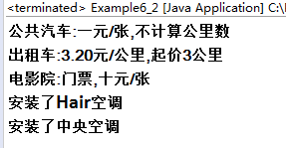
public class Example6_2 {
public static void main(String args[]) {
公共汽车 七路=new 公共汽车();
出租车 天宇=new 出租车();
电影院 红星=new 电影院();
七路.收取费用();
天宇.收取费用();
红星.收取费用();
天宇.controlTemperature();
红星.controlTemperature();
}
}

Slide 30
Using Interface References
You can create an interface reference variable. Such a variable can refer to any object that implements its interface.
For example, if Com is an interface, ImpleCom is the class that implemented the interface. The interface reference can be defined as follows:
Com com = new ImpleCom();
Or
Com com;
ImpleCom iCom = new ImpleCom();
com = iCom;
Do you still remember the superclass reference?

Slide 31
Interface References Demo
public interface Com {
int compute1(int x,int y);
}
public class ImpleCom implements Com {
public int compute1(int x, int y) {
return x+y;
}
public int compute2(int x, int y){
return x-y;
}
}

Slide 32
public class Example_6_2_2 {
public static void main(String[] args) {
//Interface reference
Com com1 = new ImpleCom();
//Object of Implemented class
ImpleCom com2 = new ImpleCom();
//Both of output 5
System.out.println(com1.compute1(2, 3));
System.out.println(com2.compute1(2, 3));
//Error, the interface reference cannot call
//the method not defined in the interface.
//System.out.println(com1.compute2(2,3));
//Cast to the implemented class object
System.out.println(((ImpleCom)com1).compute2(2, 3));
}
}

Slide 33
Graph Introduction of Interface Reference
Implemented methods
reference
object
Other methods
The interface reference can only call the implemented methods from the implemented classes.
The interface reference might call other methods after casting to the implemented class objects.

Slide 34
Interface Reference Demo
public class ByTwos implements Series {
int start;
int val;
ByTwos(){
start = 0;
val = 0;
}
@Override
public int getNext() {
val += 2;
return val;
}
@Override
public void reset() {
val = start;
}
@Override
public void setStart(int x) {
start = x;
val = x;
}
}
public class ByThrees implements Series {
int start;
int val;
ByThrees(){
start = 0;
val = 0;
}
@Override
public int getNext() {
val += 3;
return val;
}
@Override
public void reset() {
val = start;
}
@Override
public void setStart(int x) {
start = x;
val = x;
}
}

Slide 35
public class SeriesDemo2 {
public static void main(String[] args) {
// TODO Auto-generated method stub
ByTwos twoOb = new ByTwos();
ByThrees threeOb = new ByThrees();
Series ob;
for(int i = 0; i < 5; i++) {
ob = twoOb;
System.out.println("Next ByTwos value is: " +
ob.getNext());
ob = threeOb;
System.out.println("Next ByThrees value is: " +
ob.getNext());
}
}
}

Slide 36
Interface Oriented Programming
public interface Advertisement { //接口
public void showAdvertisement();
public String getCorpName();
}
public class BlackLandCorp implements Advertisement {
public void showAdvertisement(){
System.out.println("**************");
System.out.printf("劳动是爹\n土地是妈\n想种啥来\n就往外接\n");
System.out.println("**************");
}
public String getCorpName() {
return "黑土集团" ;
}
}

Slide 37
Interface Oriented Programming
public class WhiteCloudCorp implements Advertisement {
public void showAdvertisement(){
System.out.println("@@@@@@@@@@@@@@@@@@@@@@");
System.out.printf("飞机中的战斗机，哎yes!\n");
System.out.println("@@@@@@@@@@@@@@@@@@@@@@");
}
public String getCorpName() {
return "白云有限公司" ;
}
}
public class RedCow implements Advertisement {
public void showAdvertisement() {
System.out.println("劲道十足！");
}
public String getCorpName() {
return "红牛饮料";
}
}

Slide 38
public class AdvertisementBoard { //负责创建广告牌
public void show(Advertisement adver) {
System.out.println(adver.getCorpName()+"的广告词如下:");
adver.showAdvertisement(); //接口引用调用方法
}
public class Example6_5 {
public static void main(String args[]) {
AdvertisementBoard board = new AdvertisementBoard();
board.show(new BlackLandCorp());
board.show(new WhiteCloudCorp());
board.show(new RedCow());
}
}

Slide 39
Variables in Interfaces
As mentioned, variables can be declared in an interface, but they are implicitly public, static, and final, resulting in constants.
We can define a set of shared constants, create an interface that contains only these constants, without any methods. Each file that needs access to the constants simply “implements” the interface. This brings the constants into view.

Slide 40
Variables in Interfaces
interface IConst {
int MIN = 0;
int MAX = 10;
String ERRORMSG = "Boundary Error";
}
public class IConstD implements IConst {
public static void main(String[] args) {
// TODO Auto-generated method stub
int nums[] = new int[MAX];
for(int i = MIN; i < 11; i++) {
if(i >= MAX) System.out.println(ERRORMSG);
else {
nums[i] = i;
System.out.print(nums[i] + " ");
}
}
}
}

Slide 41
Interfaces Can Be Extended
One interface can inherit another by use of the keyword extends. The syntax is the same as for inheriting classes.
The only difference is one interface can be extended by multiple interfaces.

Slide 42
interface A {
void meth1();
void meth2();
}
interface B extends A {
void meth3();
}
public class MyClass implements B {
@Override
public void meth1() {
// TODO Auto-generated method stub
System.out.println("Implement meth1()");
}
@Override
public void meth2() {
// TODO Auto-generated method stub
System.out.println("Implement meth2()");
}
@Override
public void meth3() {
// TODO Auto-generated method stub
System.out.println("Implement meth3()");
}
}

Slide 43
Another Example
interface 收费 {
public void 收取费用();
}
interface 调节温度 {
public void controlTemperature();
}
//使用接口继承
interface 控制器 extends 收费,调节温度{
}

Slide 44
class 公共汽车 implements 收费 {
public void 收取费用() {
System.out.println("公共汽车:一元/张,不计算公里数");
}
}
class 出租车 implements 控制器 {
public void 收取费用() {
System.out.println("出租车:3.20元/公里,起价3公里");
}
public void controlTemperature() {
System.out.println("安装了Hair空调");
}
}
class 电影院 implements 控制器 {
public void 收取费用() {
System.out.println("电影院:门票,十元/张");
}
public void controlTemperature() {
System.out.println("安装了中央空调");
}
}

Slide 45
Default Interface Methods
The release of JDK8 enables you a new capability to interface called the default method.
A default method in an interface would have a body, rather than being abstract.

Slide 46
Default Method Fundamentals
An interface default method is defined similar to the way a method is defined by a class. The primary difference is that the declaration is preceded by the keyword default.
public interface MyIF {
int getUserID();
default int getAdminID() {
return 1;
}
}
public class MyIfImp implements MyIF {
@Override
public int getUserID() {
// TODO Auto-generated method stub
return 100;
}
}

Slide 47
public class DefaultMethodDemo {
public static void main(String[] args) {
// TODO Auto-generated method stub
MyIF obj = new MyIfImp();
System.out.println("User ID is " + obj.getUserID());
System.out.println("Admin ID is " + obj.getAdminID());
}
}

Slide 48
Default Method Fundamentals
The default method can also be overridden in its implemented class.
public class MyIfImp2 implements MyIF {
@Override
public int getUserID() {
// TODO Auto-generated method stub
return 100;
}
public int getAdminID() {
return 42;
}
}

Slide 49

A More Comprehensive Example of Default Method
public interface Series {
int getNext();
void reset();
void setStart(int x);
default int[] getNextArray(int n) {
int[] vals = new int[n];
for(int i = 0; i < n; i++)
vals[i] = getNext();
return vals;
}
}
import java.util.Arrays;
public class SeriesDemo3 {
public static void main(String[] args) {
// TODO Auto-generated method stub
Series ob = new ByTwos();
ob.setStart(5);
int[] results = ob.getNextArray(6);
System.out.println(Arrays.toString(results));
}
}

Slide 50
Benefits for Default Method
It gives you a way to gracefully evolve interfaces over time without breaking existing code.
It provides optional functionality without requiring that a class provide a placeholder implementation when that functionality is not needed.

Slide 51
Multiple Inheritance Issues
If two interfaces have the same declaration of default method, and both of them are implemented by the same class, then it will cause issues.
public interface Alpha {
double sum(double[] a);
default double average(double[] a, int n) {
return sum(a)/n;
}
}
public interface Beta {
double product(double[] a);
default double average(double[] a, int n) {
return Math.pow(product(a),1.0/n);
}
}

Slide 52
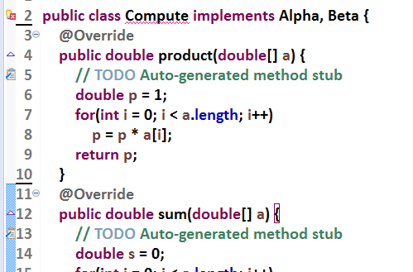
Multiple Inheritance Issues
The error means that the methods of the same name cause an ambiguity, so that you must override it.

Slide 53
Multiple Inheritance Issues
If one interface is extended from another, then the implemented class will use the inherited one by default.
public interface Alpha {
double sum(double[] a);
default double average(double[] a, int n) {
return sum(a)/n;
}
}
public interface Beta extends Alpha {
double product(double[] a);
default double average(double[] a, int n) {
return Math.pow(product(a),1.0/n);
}
}

Slide 54
Multiple Inheritance Issues
You can override the default method using the super keyword by:
interface.super.method
public interface Gamma extends Alpha {
double cov(double[] a);
@Override
default double average(double[] a, int n) {
// TODO Auto-generated method stub
return Alpha.super.average(a, n) / 2;
}
}

Slide 55
Improvement
public interface Alpha {
double sum(double[] a);
default double average(double[] a, int n) {
return sum(a)/n;
}
}
public interface Beta {
double product(double[] a);
default double average(double[] a, int n) {
return Math.pow(product(a),1.0/n);
}
}
public interface Gamma extends Alpha,Beta {
double cov(double[] a);
@Override
default double average(double[] a, int n) {
// TODO Auto-generated method stub
return (Alpha.super.average(a, n) + Beta.super.average(a, n)) /2;
}
}

Slide 56
Use static Methods in an Interface
JDK 8 added another new capability to interface: the ability to define one or more static methods. Like static methods in a class, a static method defined by an interface can be called independently of any object. Here is the general form:
InterfaceName.staticMethodName
But the static interface methods are not inherited by either an implementing class or a subinterface.

Slide 57

public interface Constants {
double PI = 3.1415926;
int OUTERR = 0;
int INERR = 1;
int DISKERR = 2;
int INDEXERR = 3;
static int add(int a, int b) {
return a+b;
}
static int sub(int a, int b) {
return a-b;
}
}
public class ConstantDemo {
public static void main(String[] args) {
// TODO Auto-generated method stub
double r = 5.0;
double area = Constants.PI * r *r;
System.out.println("Area is: " + area);
System.out.println("Message is :" + Constants.DISKERR);
double sum = Constants.add(5, 6);
System.out.println("add(5,6) is: " + sum);
}
}

Slide 58
Private Interface Methods
Beginning with JDK 9, an interface can include a private method. A private interface method can be called only by a default method or another private method defined by the same interface. Because a private interface method is specified private, it cannot be used by code outside the interface in which it is defined. This restriction includes subinterfaces because a private interface method is not inherited by a subinterface.

